Slide 1
Introducing Vidyo
Vidyo’s PowerPoint template guide
Owner: Stephanie Taglianetti
Creative Director
May 15, 2017

Slide 2
Ground Rules
Basic PowerPoint guidelines for Vidyo

Slide 3
What Not to Do
Sub-title Goes Here
Do not pull non-licensed images off of Google for your presentations
Do not create new layouts unless you absolutely have to (example adding 5 columns instead of 4).
Do not make your text size smaller than 12px generally.
Do not grab non-Vidyo icons from the internet. Email branding@vidyo.com to create you a custom icon if you need one.
Do not copy a slide from another deck without changing the colors to match the theme of our current deck.
Do not use another deck aside from this one or combine this deck with another deck without approval.

Slide 4
Layouts
The following slides are the basic, default layout options built into the template.

Slide 5
Basic Layout
Sub-title Goes Here
First bullet – Arial, 20
Second bullet – Arial, 18
Third bullet – Arial, 16
Fourth bullet – Arial 14
Paragraph heading – Arial 20
Paragraph text– Arial, 18
Paragraph text should be no larger than 18px
Font size may not be smaller than 12px.

Slide 6
Title Slide A – Arial, 48 pt
Subtitle – Arial, 24 pt
Presenter Name – Arial, Bold, 14 pt
Presenter Title – Arial, Bold, 14 pt
Month Day, Year

Slide 7
Title Slide B – Arial, 48 pt
Subtitle – Arial, 24 pt
Presenter Name – Arial, Bold, 14 pt
Presenter Title – Arial, Bold, 14 pt
Month Day, Year

Slide 8
Title Slide C – Arial, 48 pt
Subtitle – Arial, 24 pt
Presenter Name – Arial, Bold, 14 pt
Presenter Title – Arial, Bold, 14 pt
Month Day, Year

Slide 9
Agenda – Grey Background

Slide 10
2-Column Agenda with Headings - Grey
Arial Bold – 20pt
Arial Bold – 20pt

Slide 11
Agenda – Blue Background
List your agenda here

Slide 12
2-Column Agenda with Headings– Arial, 36 pt
Arial, Bold, 20 pt
Arial, Bold, 20 pt
First bullet – Arial, 18
Second bullet – Arial, 16
Third bullet – Arial, 14
Fourth bullet – Arial 12
First bullet – Arial, 18
Second bullet – Arial, 16
Third bullet – Arial, 14
Fourth bullet – Arial 12

Slide 13
1-Column Layout – Arial, 36 pt
Sub-title Goes Here
First bullet – Arial, 20
Second bullet – Arial, 18
Third bullet – Arial, 16
Fourth bullet – Arial 14

Slide 14
2-Column Layout– Arial, 36 pt
Subtitle placeholder – Arial, 24
First bullet – Arial, 20
Second bullet – Arial, 18
Third bullet – Arial, 16
Fourth bullet – Arial 14
First bullet – Arial, 20
Second bullet – Arial, 18
Third bullet – Arial, 16
Fourth bullet – Arial 14

Slide 15
3-Column Layout– Arial, 36 pt
Subtitle placeholder – Arial, 24 pt
These placeholders can hold text, table, charts, smart art or media.
These placeholders can hold text, table, charts, smart art or media.
These placeholders can hold text, table, charts, smart art or media.

Slide 16
4-Column Layout – Arial 36pt
Sub-title placeholder – Arial 24pt
These placeholders can hold text, table, charts, smart art or media.
These placeholders can hold text, table, charts, smart art or media.
These placeholders can hold text, table, charts, smart art or media.
These placeholders can hold text, table, charts, smart art or media.

Slide 17
3-Column Layout – Arial 36pt
Subtitle placeholder – Arial 24pt
Arial, 20 pt
Arial, 20 pt
Arial, 20 pt
These placeholders can hold text, table, charts, smart art or media.
These placeholders can hold text, table, charts, smart art or media.
These placeholders can hold text, table, charts, smart art or media.

Slide 18

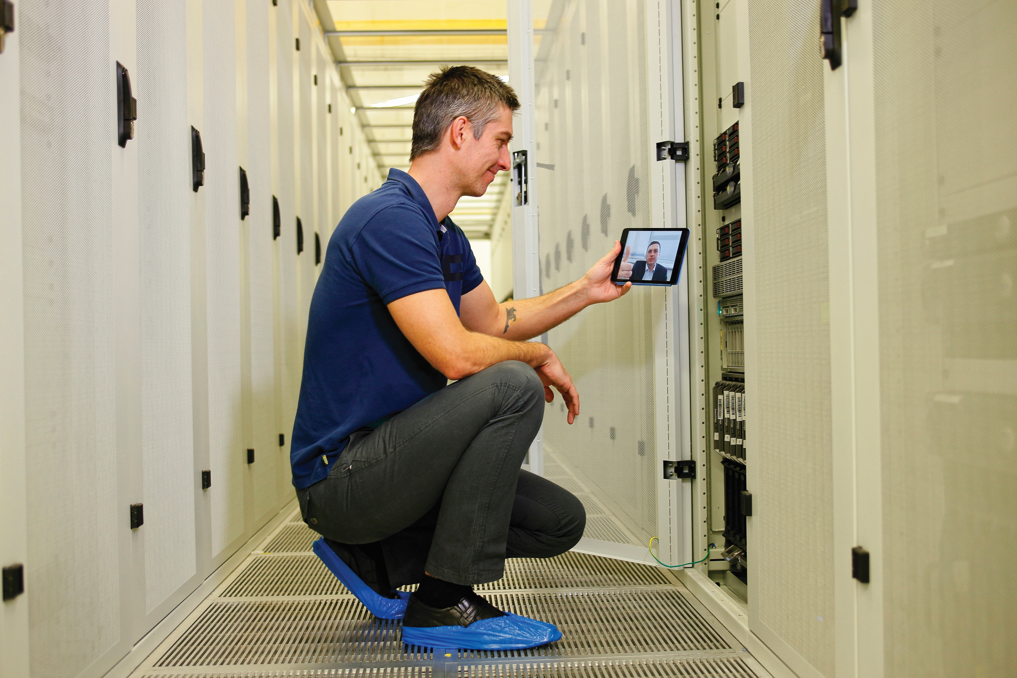

3-Column Photo Layout
Subtitle Placeholder
3-Column Photo Layout– Arial, 20 pt
Arial, 20 Pt Bold
Arial, 20 Pt Bold
Arial, 14 pt
Arial, 14 pt
Arial, 14 Pt

Slide 19



3-Column Icon Layout– Arial, 36 pt
Subtitle placeholder – Arial 24pt
Arial, 20 pt Bold
Arial, 20 pt Bold
Arial, 20 pt Bold
Arial, 14 Pt
Arial, 14 Pt
Arial, 14 pt

Slide 20
4-Column Header Layout – Arial 36px
Subtitle placeholder
Arial, 18 pt
Arial, 18 pt
Arial, 18 pt
Arial, 18pt
These placeholders can hold text, table, charts, smart art or media.
These placeholders can hold text, table, charts, smart art or media.
These placeholders can hold text, table, charts, smart art or media.
These placeholders can hold text, table, charts, smart art or media.

Slide 21
Section Slide – Arial, 40 pt
Subtitle – Arial, 24 pt

Slide 22
Section Slide – Arial, 40 pt
Subtitle – Arial, 20 pt

Slide 23
Section Slide – Arial, 40 pt
Subtitle – Arial, 20 pt

Slide 24
Graphs & Maps
Sample graphs and maps you can use

Slide 25
Slide Title – Arial, 36 pt
Arial, 11 pt
Arial, 11 pt
Arial, 11 pt
Arial, 11 pt

Slide 26
Slide Title – Arial, 36 pt
Year
Year
Month
Month
Month
Month
Month
Month
Arial, 11 pt
Arial, 11 pt
Arial, 11 pt
Arial, 11 pt
Arial, 11 pt
Arial, 11 pt

Slide 27


Arial, 16 pt
Arial, 16 pt
Arial, 16 pt
27
© Copyright 2017 Vidyo Inc., confidential, proprietary and patent pending information

Slide 28
Slide Title – Arial, 36 pt
Arial, 24 pt Bold
Arial, 24 pt Bold
Arial, 24 pt Bold
Arial, 18 pt
Arial, 18 pt
Arial, 18 pt

Slide 29




Slide Title – Arial, 36 pt
Arial, 14 pt, Bold
Arial, 12 pt
Up to 3- lines
Arial, 14 pt, Bold
Arial, 12 pt
Up to 3- lines
Arial, 14 pt, Bold
Arial, 12 pt
Up to 3- lines
Arial, 14 pt, Bold
Arial, 12 pt
Up to 3- lines

Slide 30
Slide Title – Arial, 36 pt

Slide 31
Slide Title – Arial, 36 pt

Slide 32
Slide Title – Arial, 36 pt

Slide 33
Slide Title – Arial, 36 pt

Slide 34
Customer Case Study Templates

Slide 35


Customer Case Study
Arial, 36 pt
Arial, 20 pt
Up to 4 lines
Arial, 20 pt
Up to 4 lines
Arial, 24 pt, Italic
Arial, 20 pt
Up to 4 lines

Slide 36
Customer Case Study
Arial 36pt
Arial, 20 pt
Up to 4 lines
Arial, 20 pt
Up to 4 lines
Arial, 24 pt, Italic
Arial, 20 pt
Up to 4 lines

Slide 37
Customer Case Study
Arial 36pt
Arial, 20 pt
Up to 4 lines
Arial, 20 pt
Up to 4 lines
Arial, 24 pt, Italic
Arial, 20 pt
Up to 4 lines

Slide 38
Customer Case Study
Arial 36pt
Arial, 20 pt
Up to 4 lines
Arial, 20 pt
Up to 4 lines
Arial, 24 pt, Italic
Arial, 20 pt
Up to 4 lines

Slide 39
Vertical Split Layout– Arial, 36 pt
Arial, 24 pt
First bullet – Arial, 20
Second bullet – Arial, 18
Third bullet – Arial, 16
Fourth bullet – Arial 14
Arial, 24 pt
Arial, 24 pt
Arial, 24 pt, Italic
Arial, 24 pt

Slide 40
Various Other Layouts

Slide 41
Slide Title – Arial, 36 pt
Arial, 24 pt
Arial, 24 pt
Arial, 24 pt
Arial, 14 pt
Arial, 14 pt
Arial, 14 pt
Arial, 24 pt
Arial, 24 pt
Arial, 24 pt
Arial, 14 pt
Arial, 14 pt
Arial, 14 pt

Slide 42
Arial, 12 pt
Up to 4- line text
Arial, 36 pt, 1- line or 2- line text
Arial, 12 pt
Up to 4- line text
Arial, 12 pt
Up to 4- line text
Arial, 12 pt
Up to 4- line text

Slide 43
Table Example
Heading | Heading | Heading | Heading
Data | Data | Data | Data

Slide 44
Notes:
Footer Only

Slide 45
Monitor and Screenshot
Text, images, charts, tables and smart art can be put into this placeholder.

Slide 46
Laptop and Screenshot
Text, images, charts, tables and smart art can be put into this placeholder.

Slide 47


Mobile and Screenshot
Text, images, charts, tables and smart art can be put into this placeholder.

Slide 48
Smart Art Samples

Slide 49
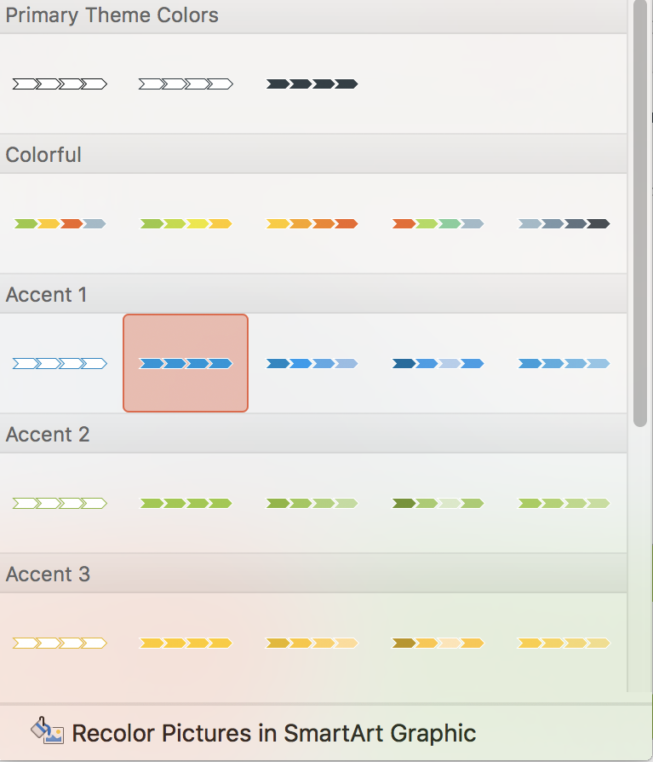
Smart Art Recoloring Tips
You can recolor smart art individually or use these primary theme colors that incorporate the template palette

Slide 50
Smart Art Samples
Notes:
Blank Slide

Slide 51
Smart Art Samples
Notes:
Blank Slide

Slide 52
Smart Art Samples
Notes:
Blank Slide

Slide 53
Smart Art Samples
Notes:
Blank Slide

Slide 54
Smart Art Samples
Notes:
Blank Slide

Slide 55
Iconography

Slide 56










































































Icons
Set Hostname
tools
Healthcare
API
Chat
Hybrid
Security
Single Sign On
Thumbnail Photo
Public Room
MacOS
Pairing
Vision
Survey
Microsoft Edge
Search
Fiirewall
H.264
Neo Pre-Call
Neo In-Call
Slack integration
Profile Features
Event Streaming
Battery
Pairing
Cart
Email Link
Rating
Neo Post-Call
Insurance
Government
Customer Centric
Partners
Call Control
24/7 Support
APIs
Deploy/Scale
Bank
HD
Reliable
Single Sign On
Installer
Event Streaming
Peripherals
Microphone
Resources
Multi-Media
Eco-Friendly
Customer Engagement
Customization
Camera Control
Bug Fix
Record
Alert
Smart Glasses
Link
No Upload
Peripherals
Meeting Room
Temperature
Calendar
Resilience
Healthcare
Please note full icon library will be available in our Google Drive within 60 days. New icons will be added
4K
Blended Audio
Support Ticket
Error Correction
Legal
IT Admin
Maintenance
View Firmware
Routing
Camera
Management
Interoperability
HTML email
Cloud Support
Interactive Management
Recovery Console
WEBRTC
Warehouse
Notes:
Blank Slide

Slide 57
Stock Images
Approved in-situation images are available here to use in your presentations

Slide 58
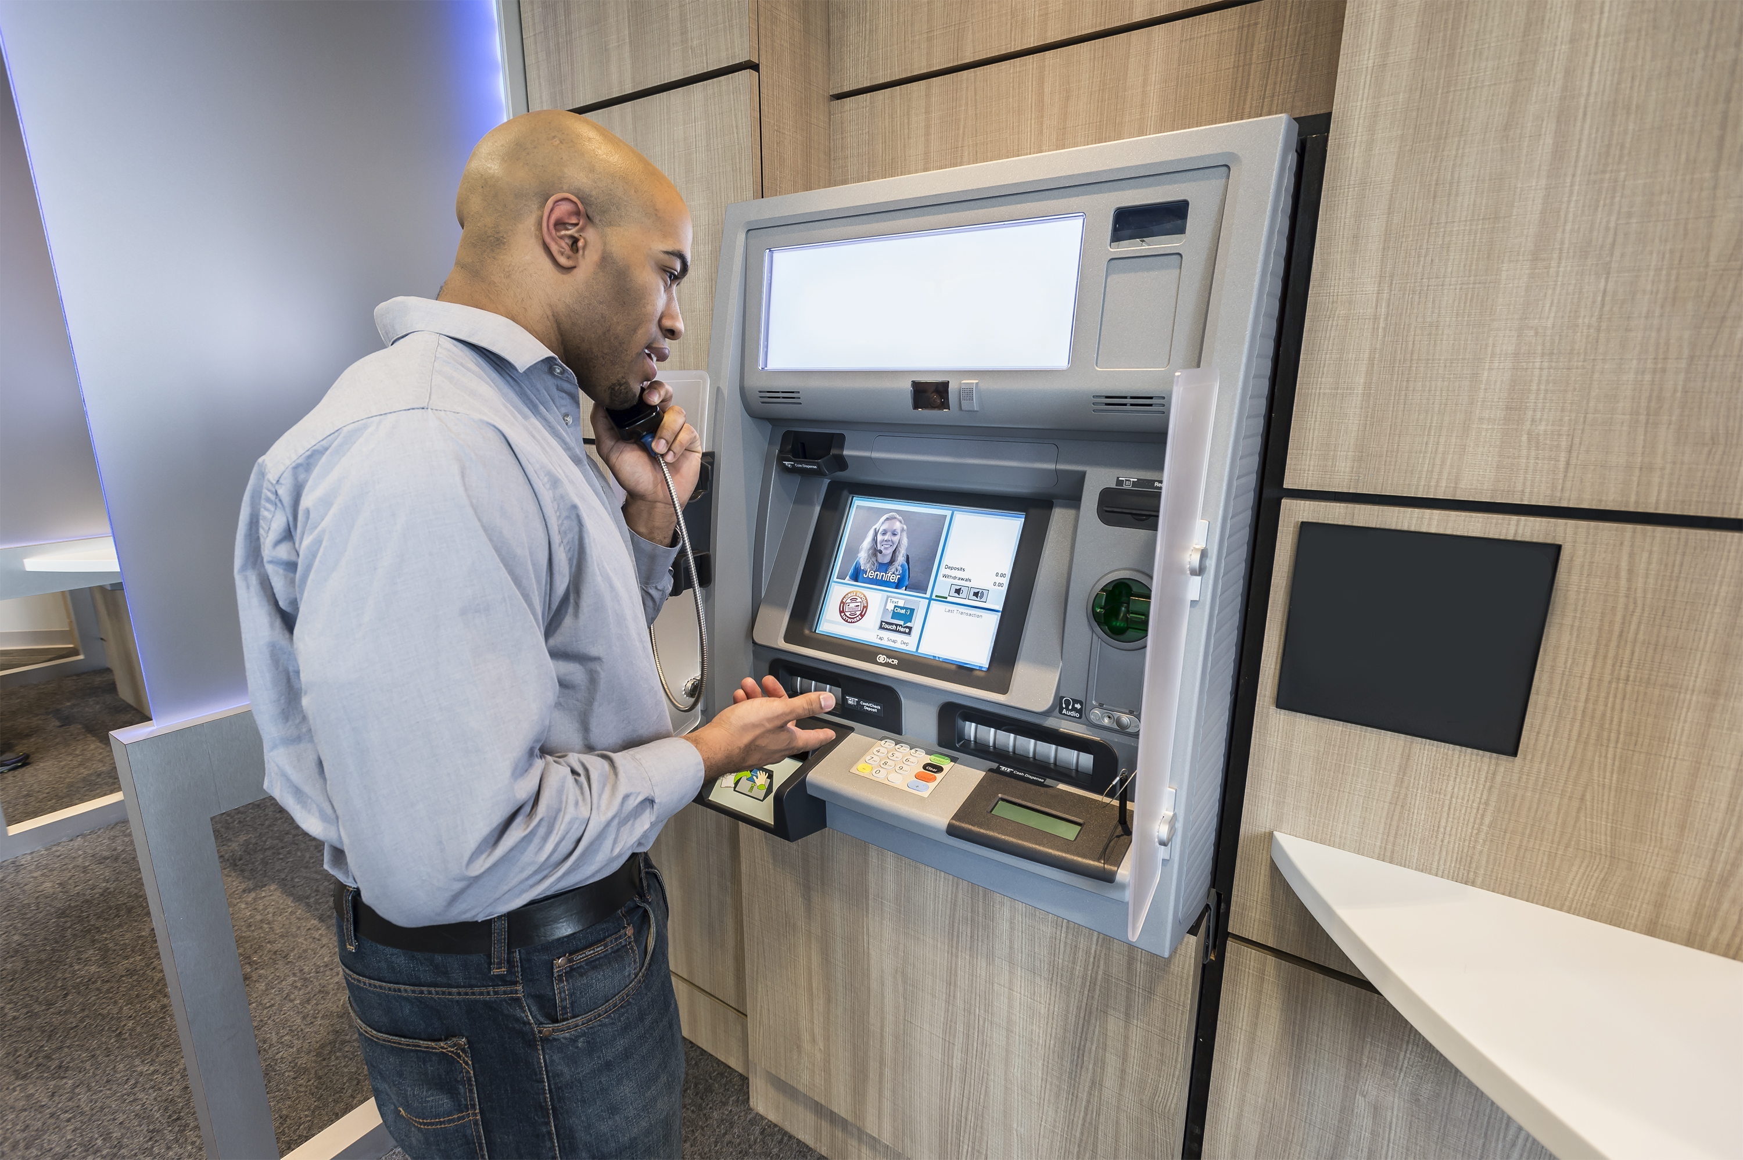



Financial Stock Photos
Please note full stock image available in our Google Drive within 60 days. There will be a specific folder of images available pre-sized for PowerPoint deck background images.
Notes:
Blank Slide

Slide 59

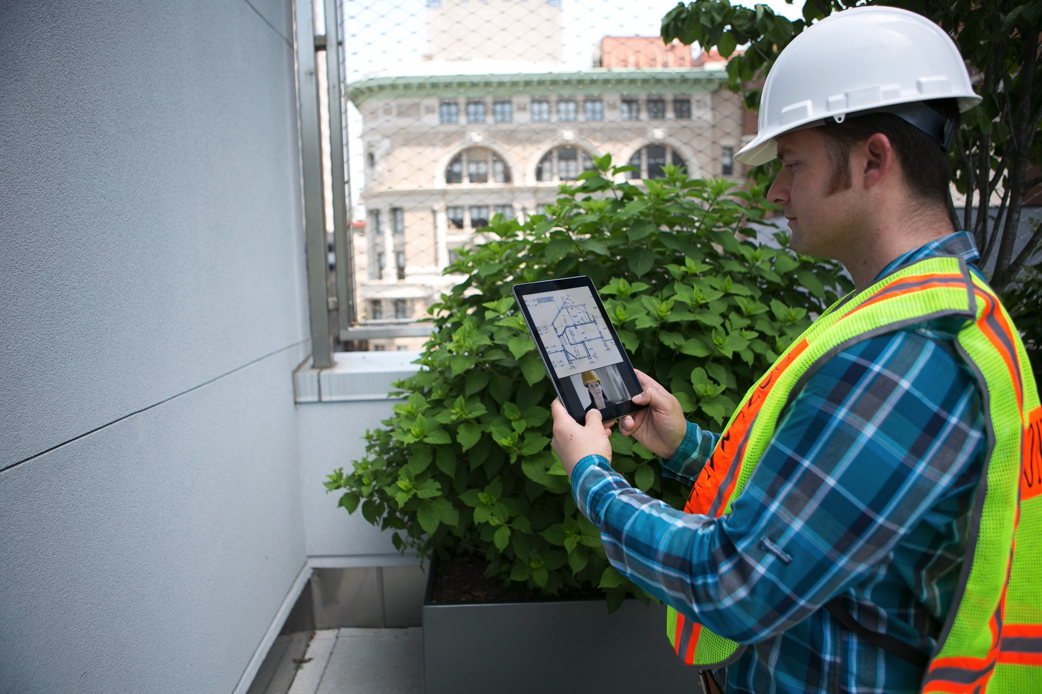



Field Services

Slide 60





Customer Engagement

Slide 61


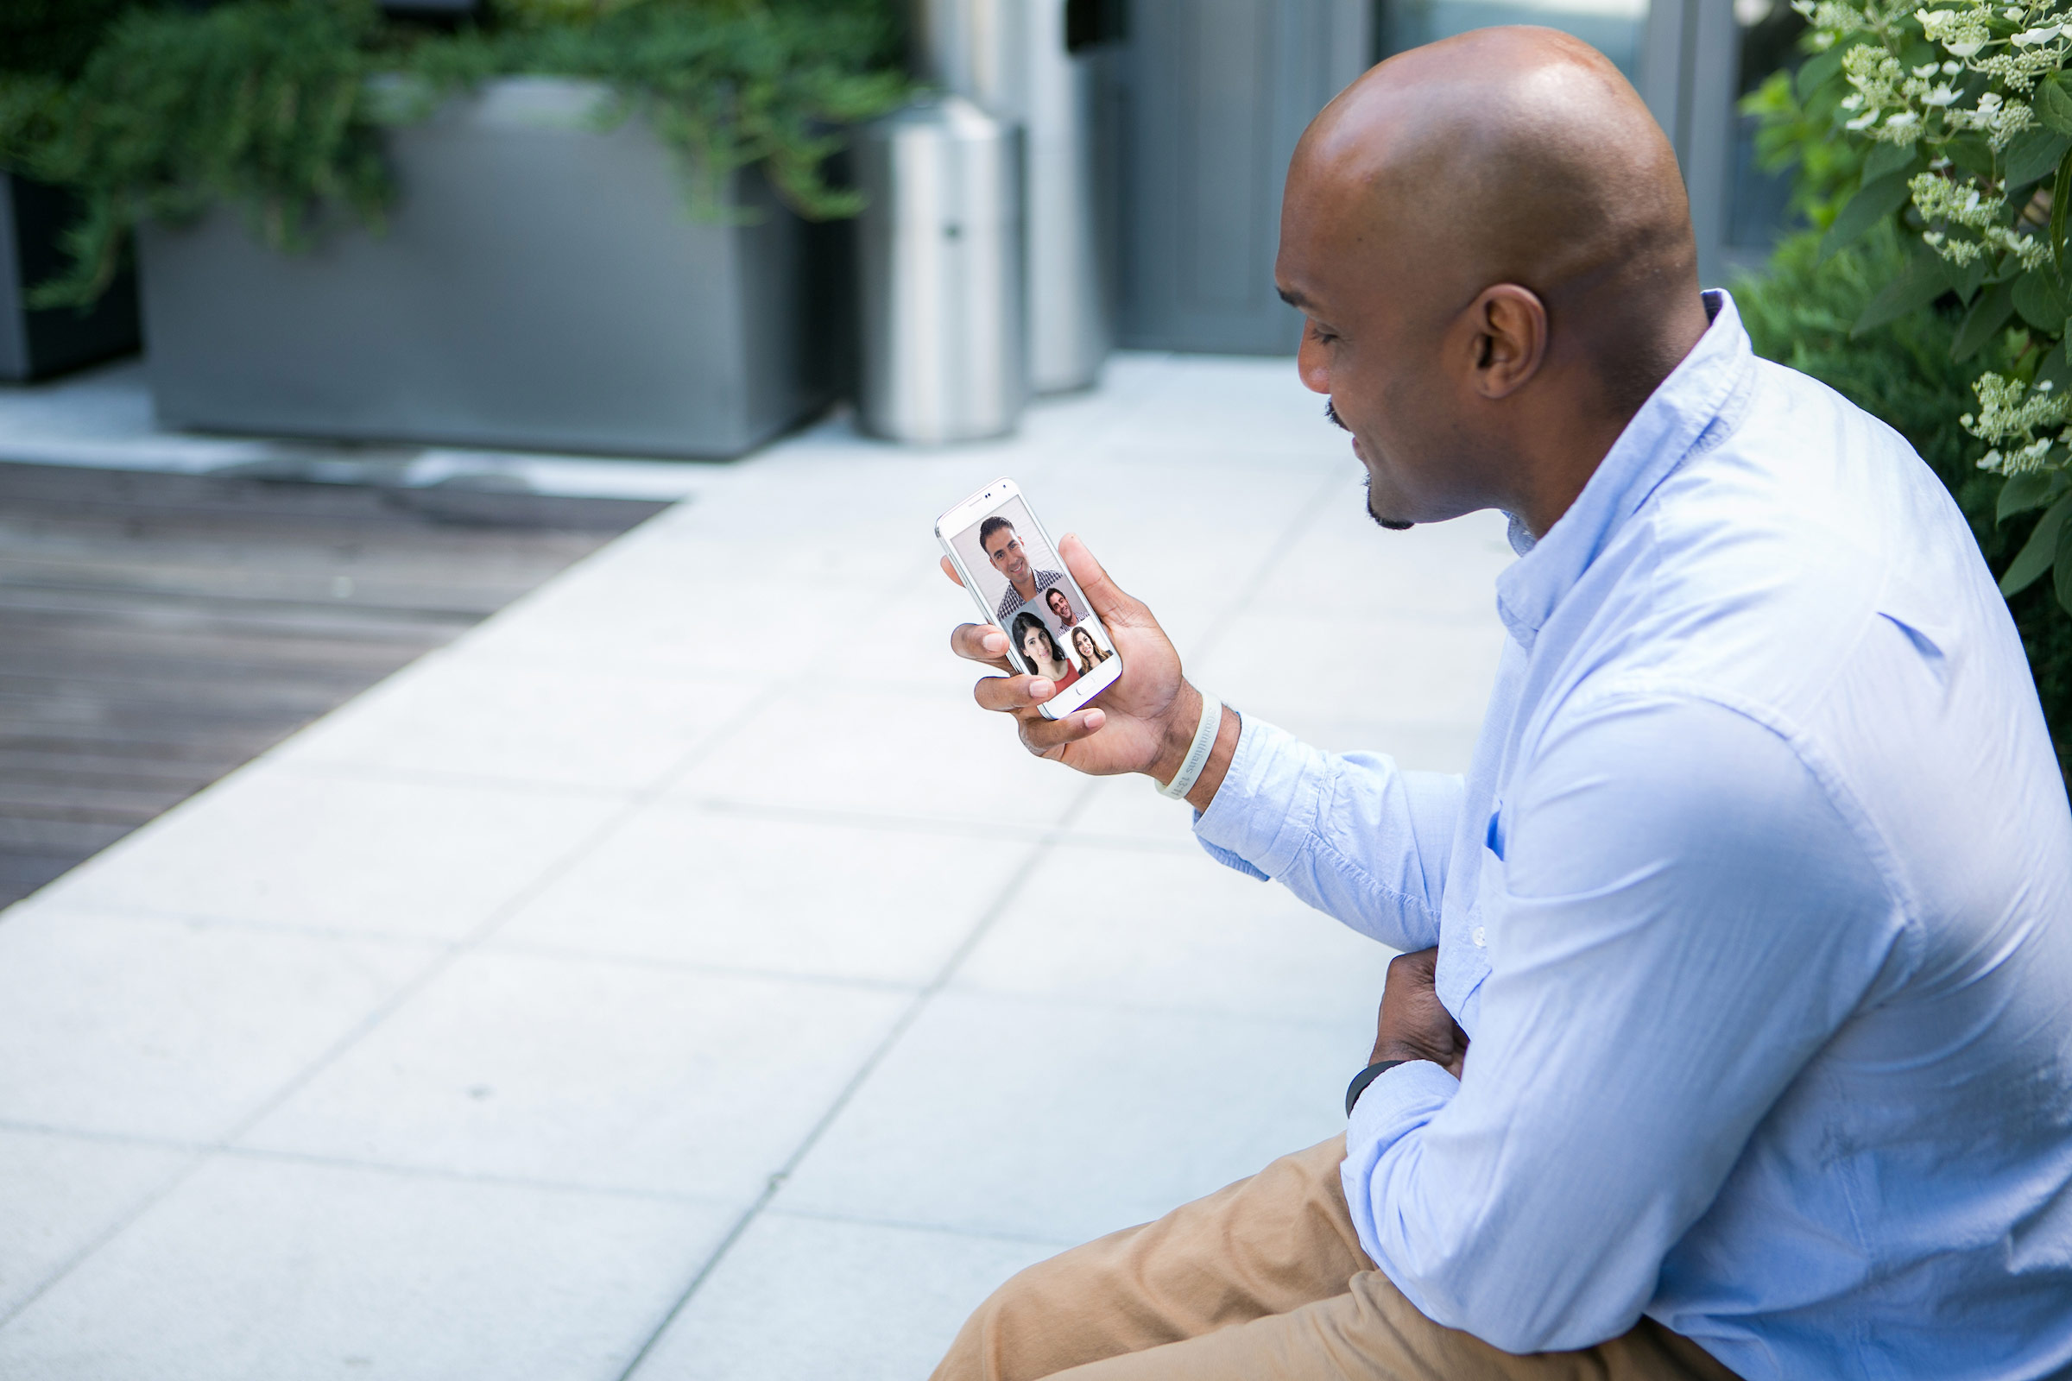


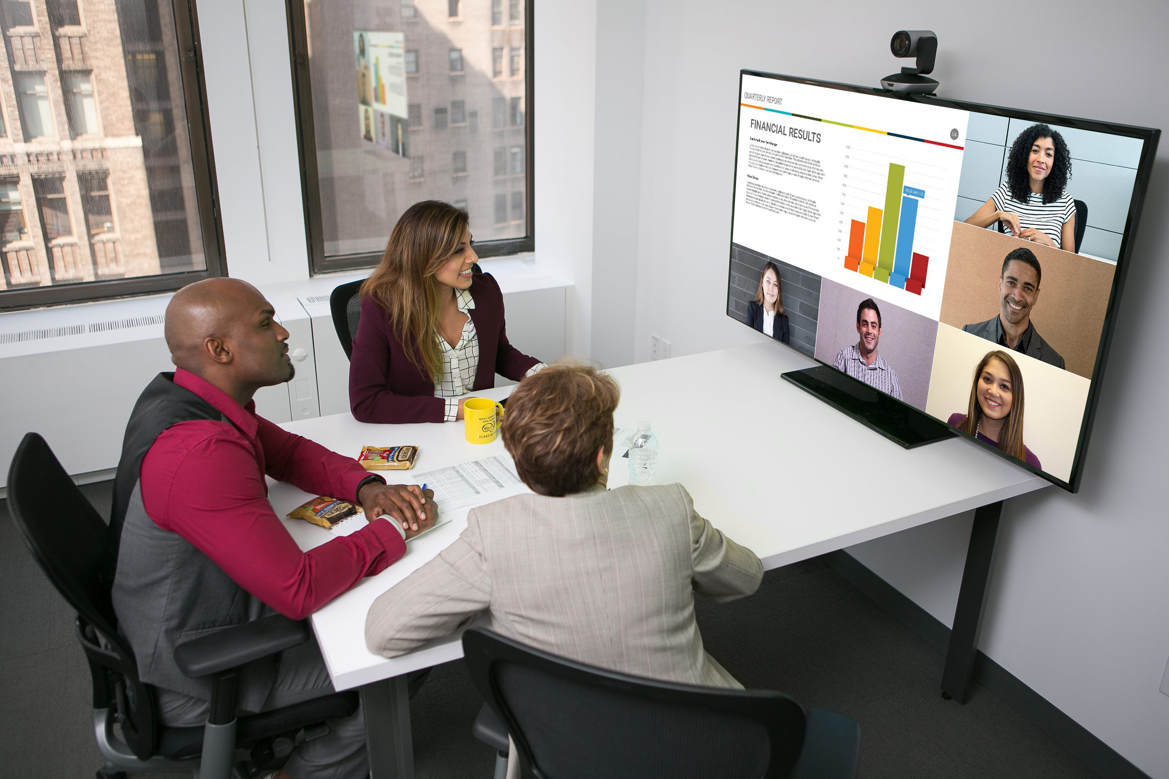
General Collaboration
Notes:
Blank Slide

Slide 62



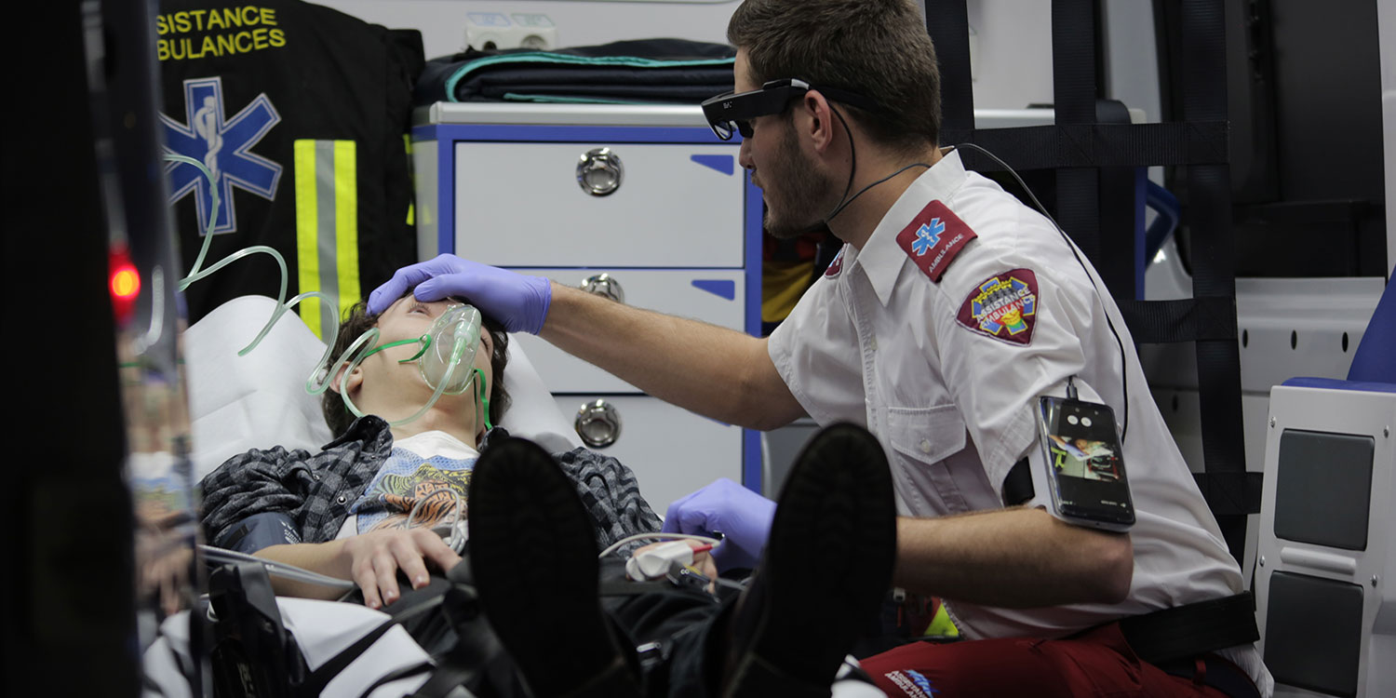


Healthcare

Slide 63
Device Templates

Slide 64


Devices
Notes:
Blank Slide

Slide 65

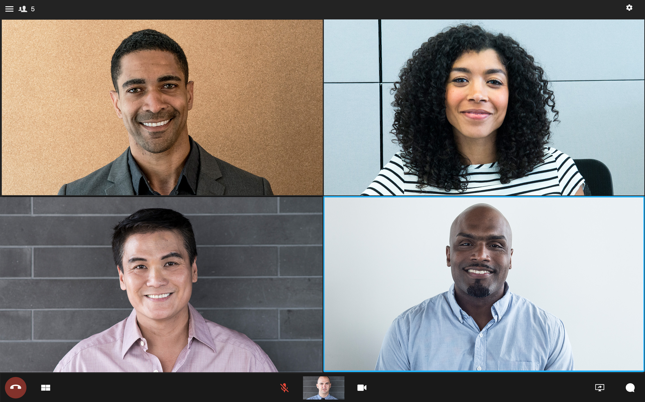
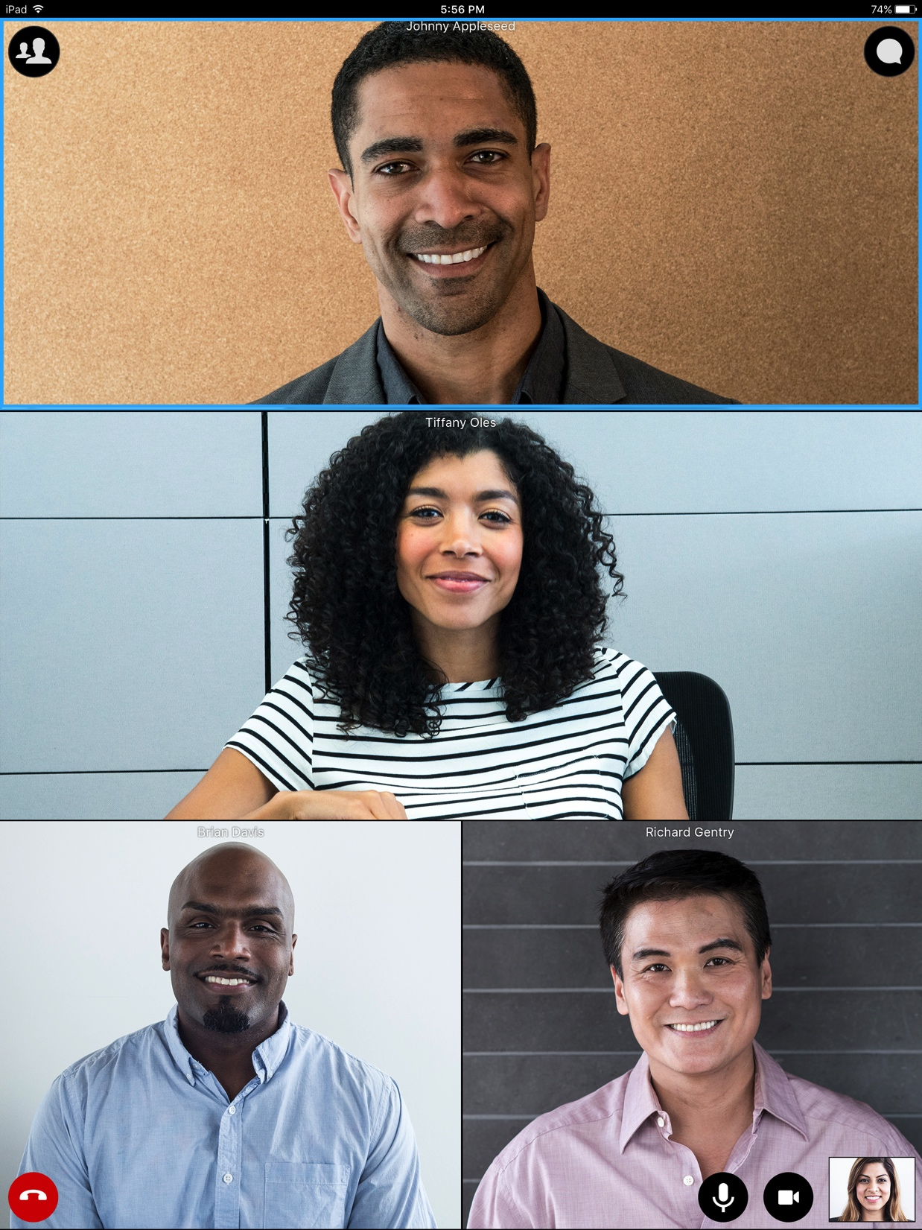

Devices with Vidyo Meetings
Notes:
Blank Slide

Slide 66
PPT Grammar Guide
Quick grammar reference guide for your PowerPoint decks.

Slide 67
Capitalization & Sentence Structure
Headlines
Bullets
In general, Vidyo uses Associated Press style when writing. What this means is that headlines when they are NOT in full sentences should be in title case UNLESS the word is an article (a, an, the), conjunction or preposition.
i.e; General Grammar Guidelines
When you are designing your writing style for your deck, decide whether you are writing in phrases or full sentences. Do NOT mix and match
Phrases
Use Title Case
Do Not Use a Period at the End of a Sentence
Sentences
Capitalize only the first letter of the sentence.
Please use a period at the end of the sentence.

Slide 68
Various Other Grammar Rules
Spell out numbers up to 10 (one, two, three) and use numerals from 10 and above.
Use numerals and the % symbol instead of the word “percent.”
If starting a sentence with a number, spell it out.
Always obtain permission and check for attribution before citing third-party content.
Do NOT capitalize non-proper nouns such as “solution” or “platform.”
For a more comprehensive list of grammar rules please view the Vidyo Brand Style Guide

Slide 69


Thank You Slide
Arial, 48 pt
Presenter Name
Presenter Name
Presenter Title
Presenter Title
Presenter Email
Presenter Email
@twitterhandle
@twitterhandle

Slide 70


Thank You Slide
Arial, 48 pt
Presenter Name
Presenter Name
Presenter Title
Presenter Title
Presenter Email
Presenter Email
@twitterhandle
@twitterhandle

Slide 71
Thank You Slide
Arial, 48 pt
Arial, 24 pt
Arial, 24 pt
Arial, 20 pt
Arial, 20 pt
Arial, 18 pt
Arial, 18 pt
@twitterhandle
@twitterhandle

Slide 72
Thank You Slide
Arial, 48 pt
Arial, 24 pt
Arial, 24 pt
Arial, 20 pt
Arial, 20 pt
Arial, 18 pt
Arial, 18 pt
@twitterhandle
@twitterhandle

